Slide 1


Slide 2


Slide 3
Adding F# to Your C# Codebase What you need to know
Jay Hill
jayhill@jayhill.net
@jittery
speakerrate.com/jayhill
github.com/jayhill

Slide 4
Adding F# to Your C# Codebase What you need to know
Jay Hill
jayhill@jayhill.net
@jittery
speakerrate.com/jayhill
github.com/jayhill

Slide 5


Slide 6
Non-Objectives
Convince you that F# is great (it is)
Convince you that C# is so over (it isn’t)
Teach you F#
Get you to add F# to your .NET project
Make false claims about F# or FP

Slide 7

Objectives
Set expectations
Highlight key trade-offs
Provide practical strategies to keep C# and F# interop code idiomatic and clean

Slide 8

Assumptions
You think that F# might be great (it is)
You don’t think C# is a golden hammer (it isn’t)
You don’t think F# is a golden hammer (it is… n’t)
You know or might learn some F#
You’re interested in adding F# to your .NET project
You understand that F# & FP don’t solve all the things

Slide 9

YOU
ME

Slide 10
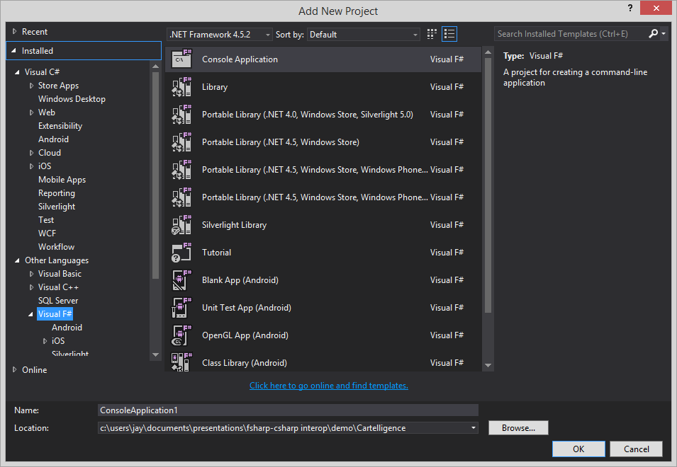
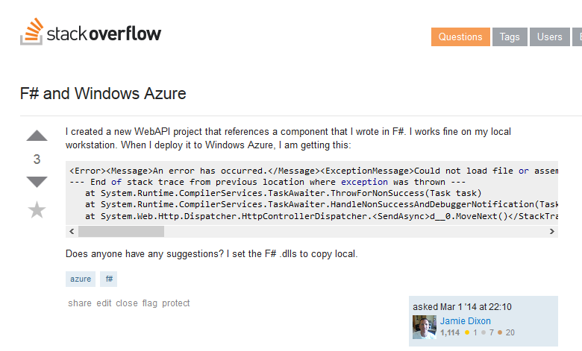
F# is not a first-class citizen

Slide 11

Beloved tools don’t love you back when you use F#
CodeRush

Slide 12

My world is crumbling

Slide 13


Slide 14
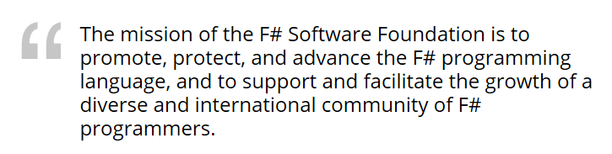
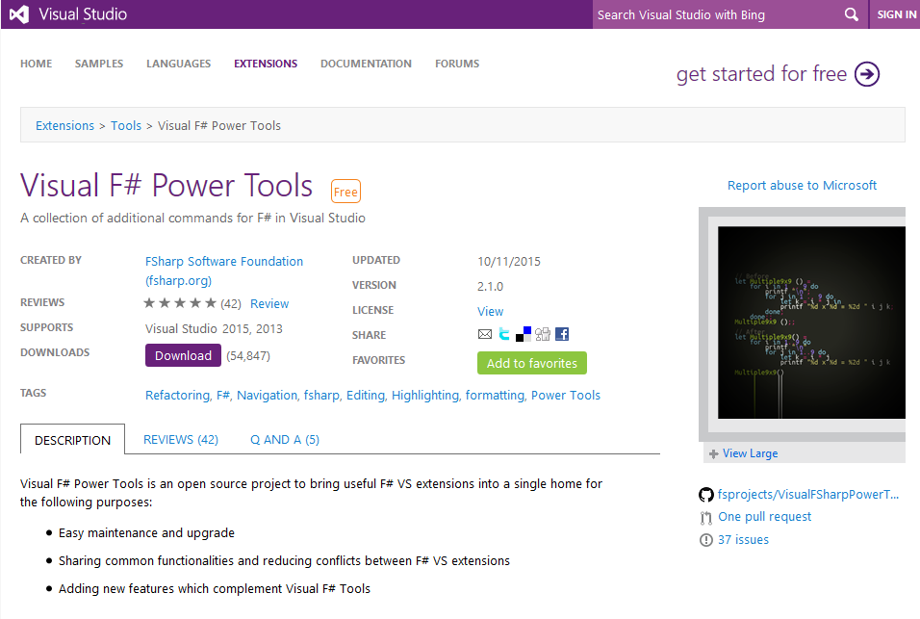
F# is a [growing] community

Slide 15
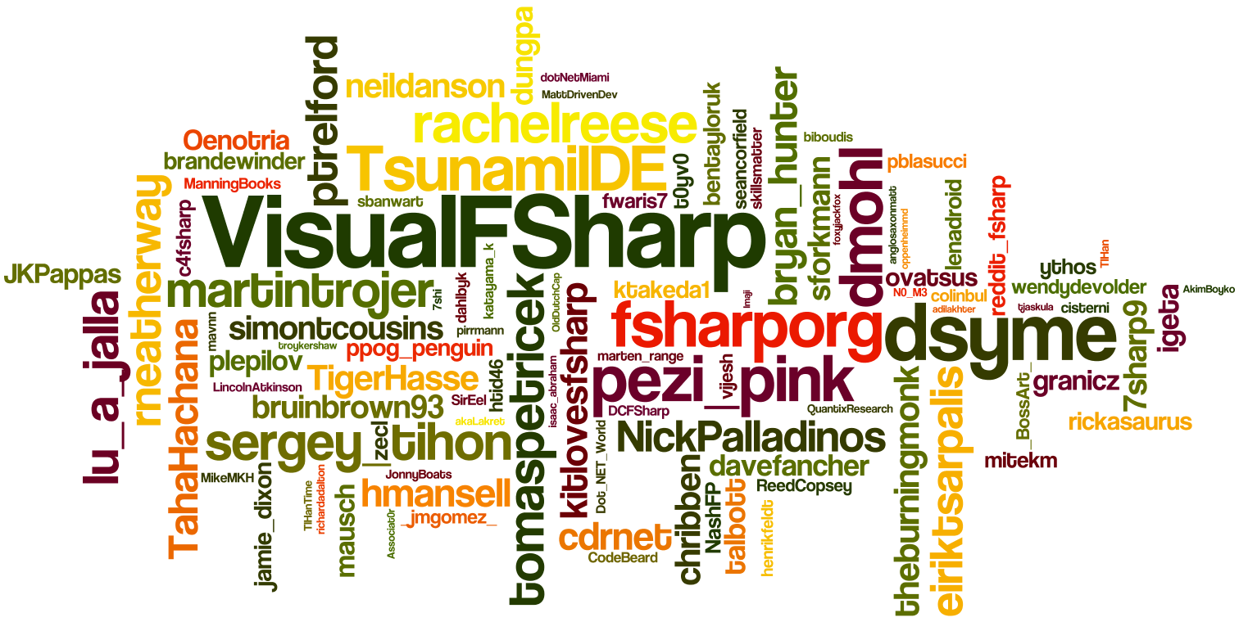
F# is a [growing] community
*Word clouds prove things

Slide 16


F# is fully .NET

Slide 17

Its provenance makes it idiomatically distinctive

Slide 18
Uses many familiar .NET types
open System
string
char
byte
int (16,32,64)
enum
object
etc.

Slide 19
Can use any .NET type
collections
expressions
web
crypto
LINQ
etc.

Slide 20
Idiomatically Distinct

Slide 21
idiomatic code
idiotic code
>

Slide 22

I DON’T ALWAYS WRITE CODE, BUT WHEN I DO,
IT IS IDIOMATIC*

Slide 23
Has its own types
unions
records
collections
tuples
modules
functions

Slide 24
Idiomatically distinct …but IL is IL
unions
records
collections
tuples
modules
functions
.NET

Slide 25
F# ♥ is about features Features are leveraged through idioms
pattern-matching
|> piping
recursion
currying
immutability
null-lessness
_
REPL

Slide 26








Tooling

Slide 27


Folding
Visual Studio does not support code folding (collapse/expand).
At all.
Not for modules, not for functions, not for types.
(meh)

Slide 28
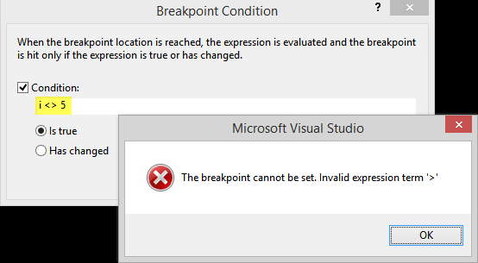
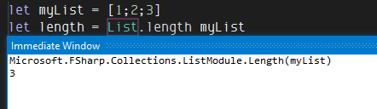
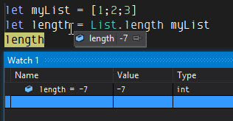
Debugging
Breakpoint conditions, Immediate, Watch and other debugging tools require C#/compiled syntax
…and they allow mutation

Slide 29
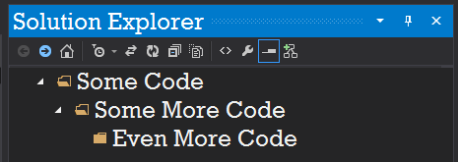
Folders: A Tale of Woe
FACT
Visual Studio does not support folders in F# projects
HOPE
F# Power Tools adds support for folders in VS
RECOMMENDATION
Don’t you do it!

Slide 30
Data Structures
FSharp.Collections FSharp.Core.ExtraTopLevelOperators (ick)
list : FSharpList<T>
map : FSharpMap<TKey,TValue>
set : FSharpSet<T>
F# Power Pack adds other useful structures, such as Matrix<T>.
All of these collection types implement expected generic and non-generic collection interfaces:
IEnumerable, IEnumerable<T>
ICollection, ICollection<T>
IDictionary<TKey, TValue>
etc.

Slide 31
Data Structures
Many F# idioms don’t work without F# types.
No list pattern-matching with IList<T>, only with FSharpList<T>.
let rec matchStrings = function
| [] -> “empty”
| [x] -> “one item: ” + x
| head::tail -> head + “, ” + (matchStrings tail)

Slide 32
Porting Classes
Members cannot be protected
Members cannot be sealed (but classes can fwiw)
Classes cannot be nested (but modules can fwiw)

